Slide 1

Data Engineering: 2022 FIFA World Cup
Solution_Makers
Members:
Dariel Ibanez
Nelson Velasco
Mia Serrano-Salow
Patricia Young

Slide 2
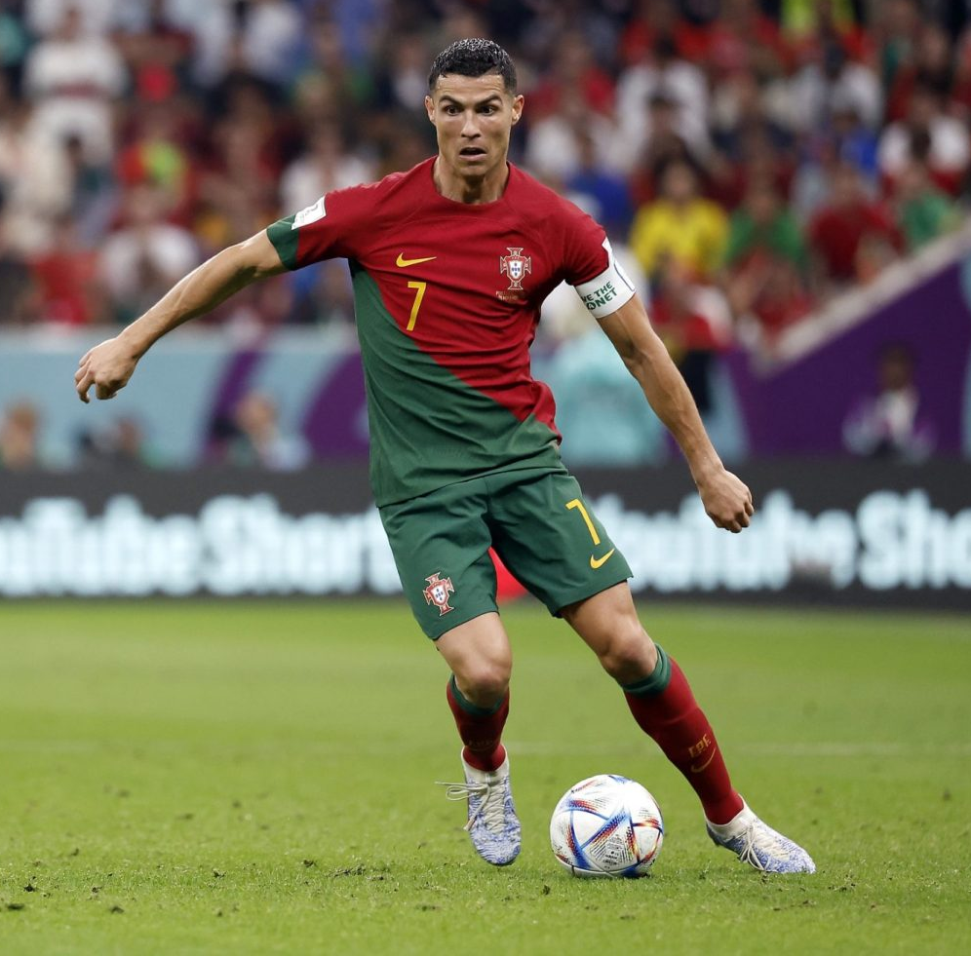
Purpose:
We are a team of sports data engineers researching player data from the 2022 FIFA World Cup for team scouts to use, to determine the best players to recruit.
We have been asked by a client company to process and upload player data from the 2022 FIFA World Cup for them to make adequate roster moves for the upcoming season.
We sorted through multiple DataFrames of players offensive and defensive stats throughout the FIFA tournament, as well as their current market value and Overall FIFA Player Score, to come up with a complete DataFrame for scouting teams to use.
We have chosen to work in the sports field because it is a topic we are all knowledgeable about and interested in.

Slide 3

Questions:
As sports data engineers working for scouting companies, some questions that we considered while performing our research were:
What factors should determine what makes the players the “best”?
Who are the players that out performed their market value during the FIFA World Cup?
Who had the most number of goals out of all the players in the FIFA World Cup?
Which players had the most touches per the amount of minutes per game?

Slide 4
Applications Used:
The datasets that we used were found on Kaggle as csv files.
The csv files were imported into Jupyter Notebook. We transformed and cleaned the data using both Pandas and Polars.
Next, we exported the dataframe as a csv file and loaded it into pgAdmin as a SQL database. Here we wanted to create several tables to be able to better manage the larger dataset.
We then exported the data back out of pgAdmin and back into the Jupyter Notebook to ensure things were working properly.
We used QuickDBD to create the ERD.
When needed, we used AskBCS for help.
Notes:
Can speak about why we chose the Kaggle datasets.
Why we chose to clean the data in the juypter notebook/python and use pandas/polars.
Why we opted for a SQL database and not a NoSQL database (we had a more structured dataset to work with which worked better with a SQL database, and we wanted to then use tables to manipulate the data to see trends and that would be better suited in a SQL database)

Slide 5
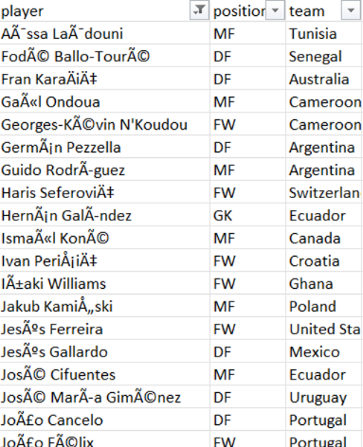
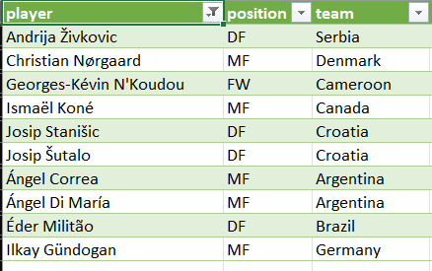
Encoded The Files as ANSI From Unicode UTF8

Slide 6
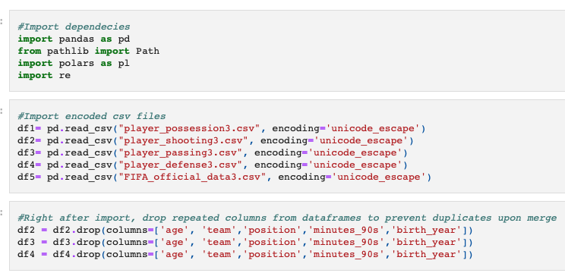
Importing Libraries and Dropping Duplicate Columns

Slide 7
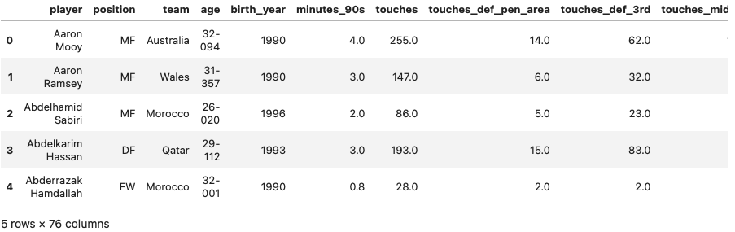
Merged DataFrames

Slide 8
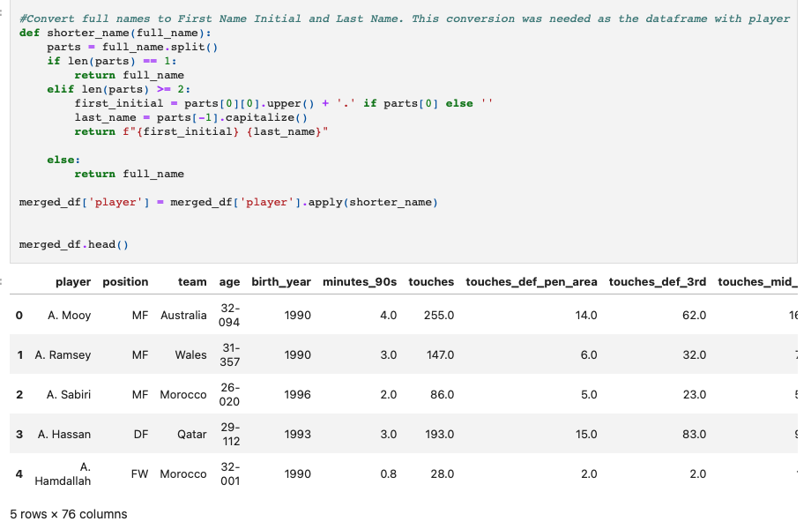
Convert Player First Names to Just Their Initial

Slide 9
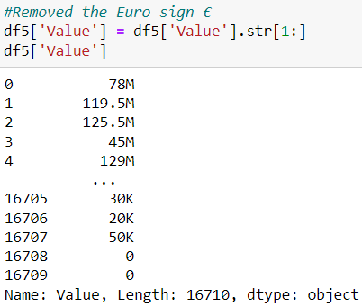
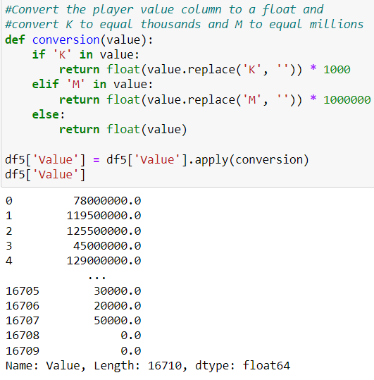
Convert Player Value Column From a String to a Float

Slide 10
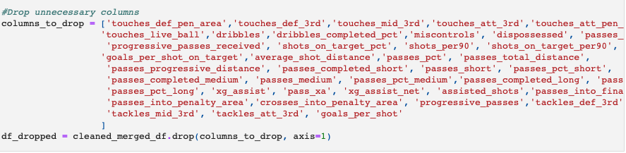
Drop Unnecessary Columns

Slide 11
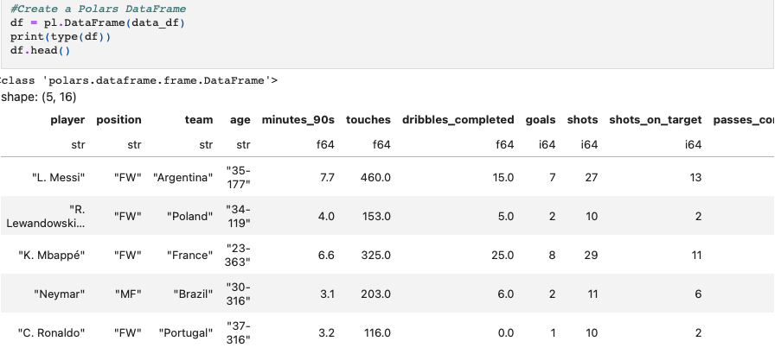
Create a Polars DataFrame

Slide 12
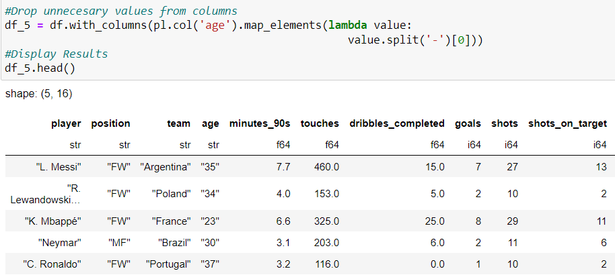
Removing Unnecessary Values

Slide 13
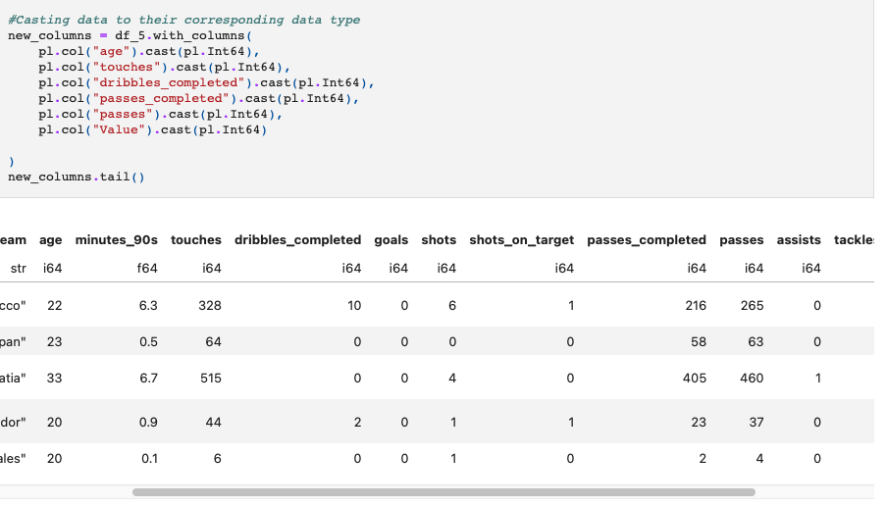
Casting Data

Slide 14
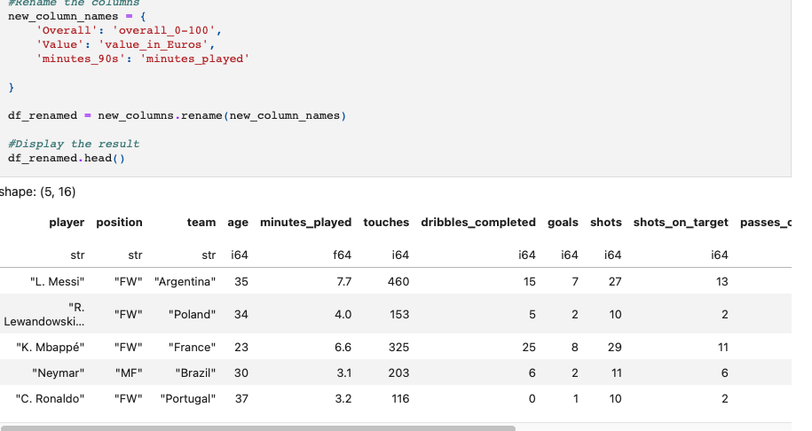
Rename Columns

Slide 15
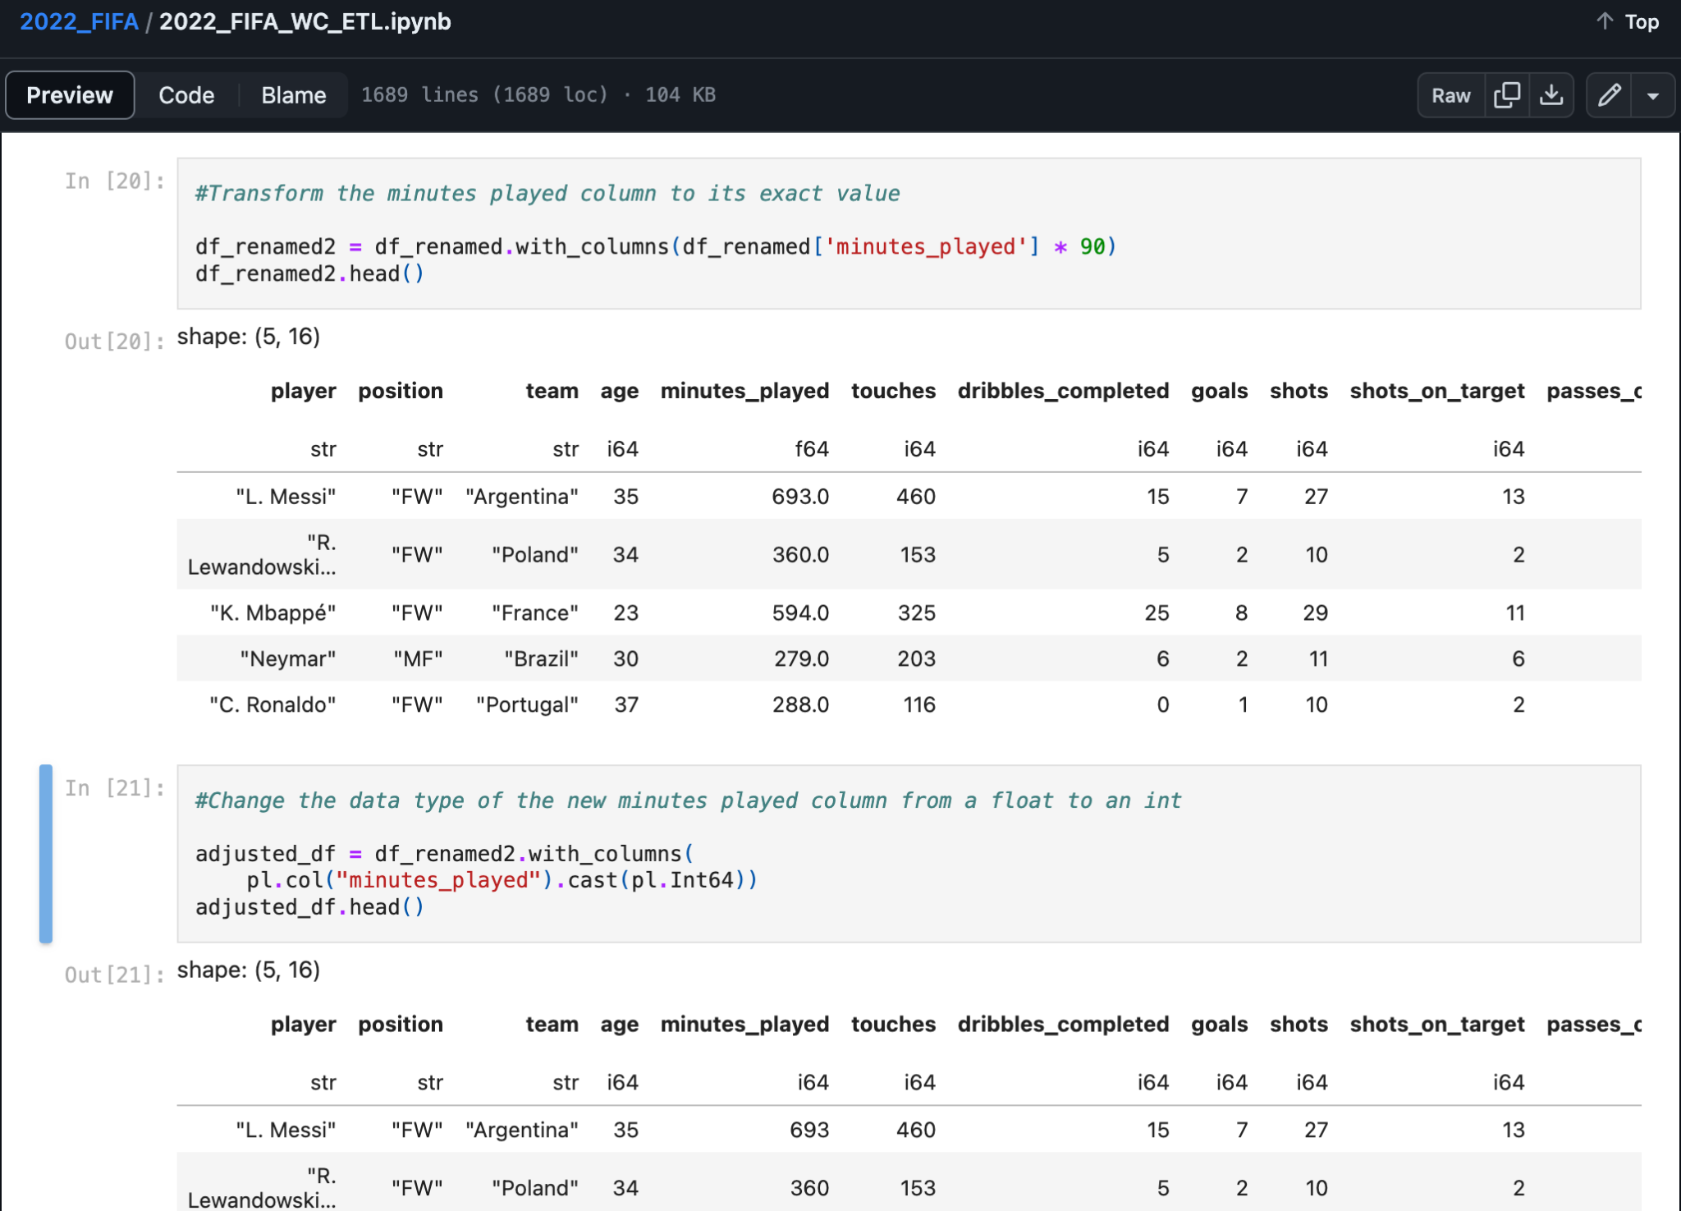
Transformation of Minutes Played Value

Slide 16
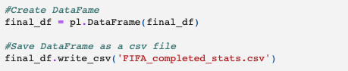
Save Final Data to CSV File

Slide 17
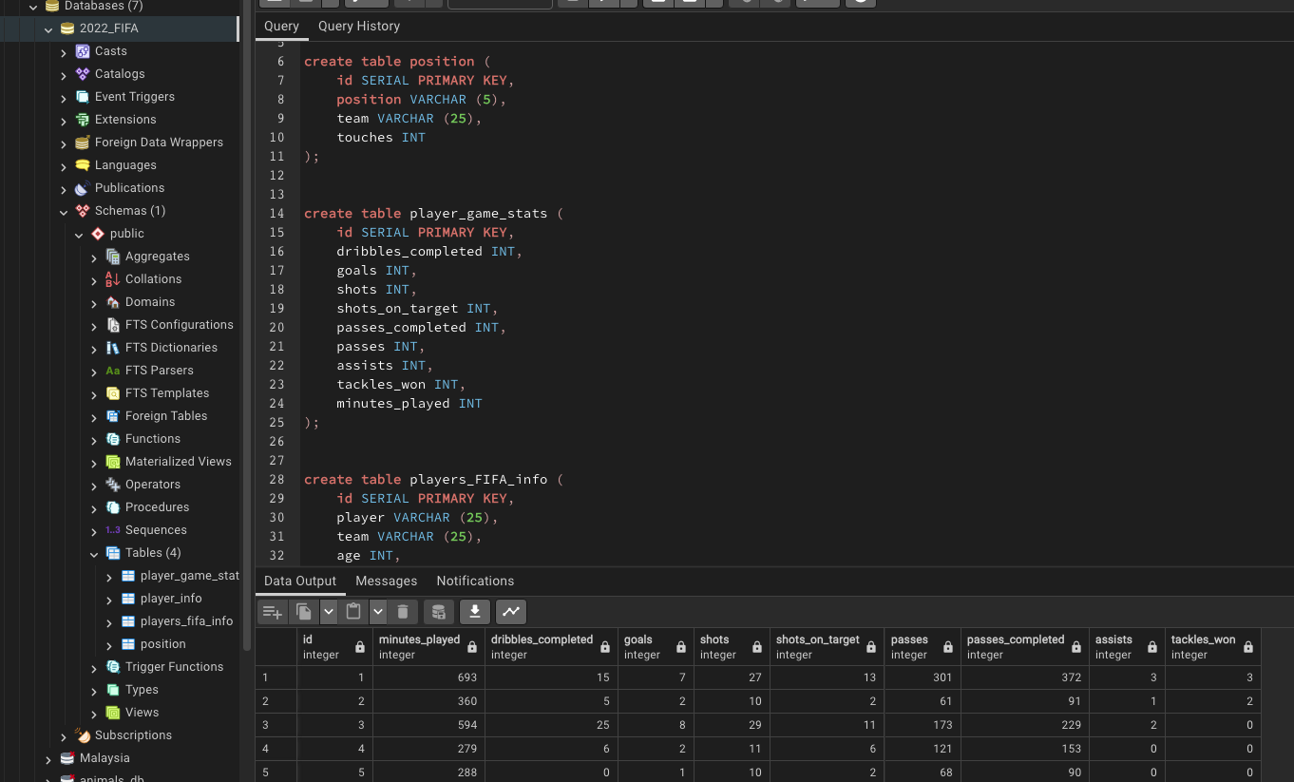
SQL Code for Tables

Slide 18
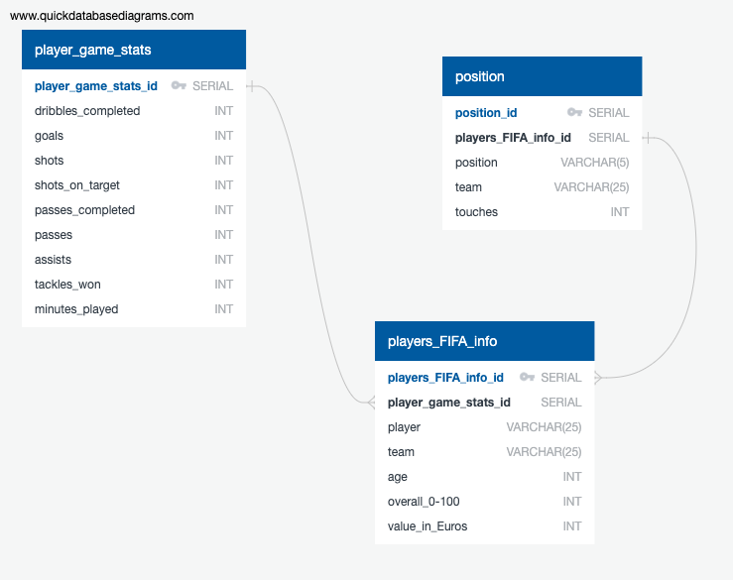
Entity Relationship Diagram (ERD)

Slide 19
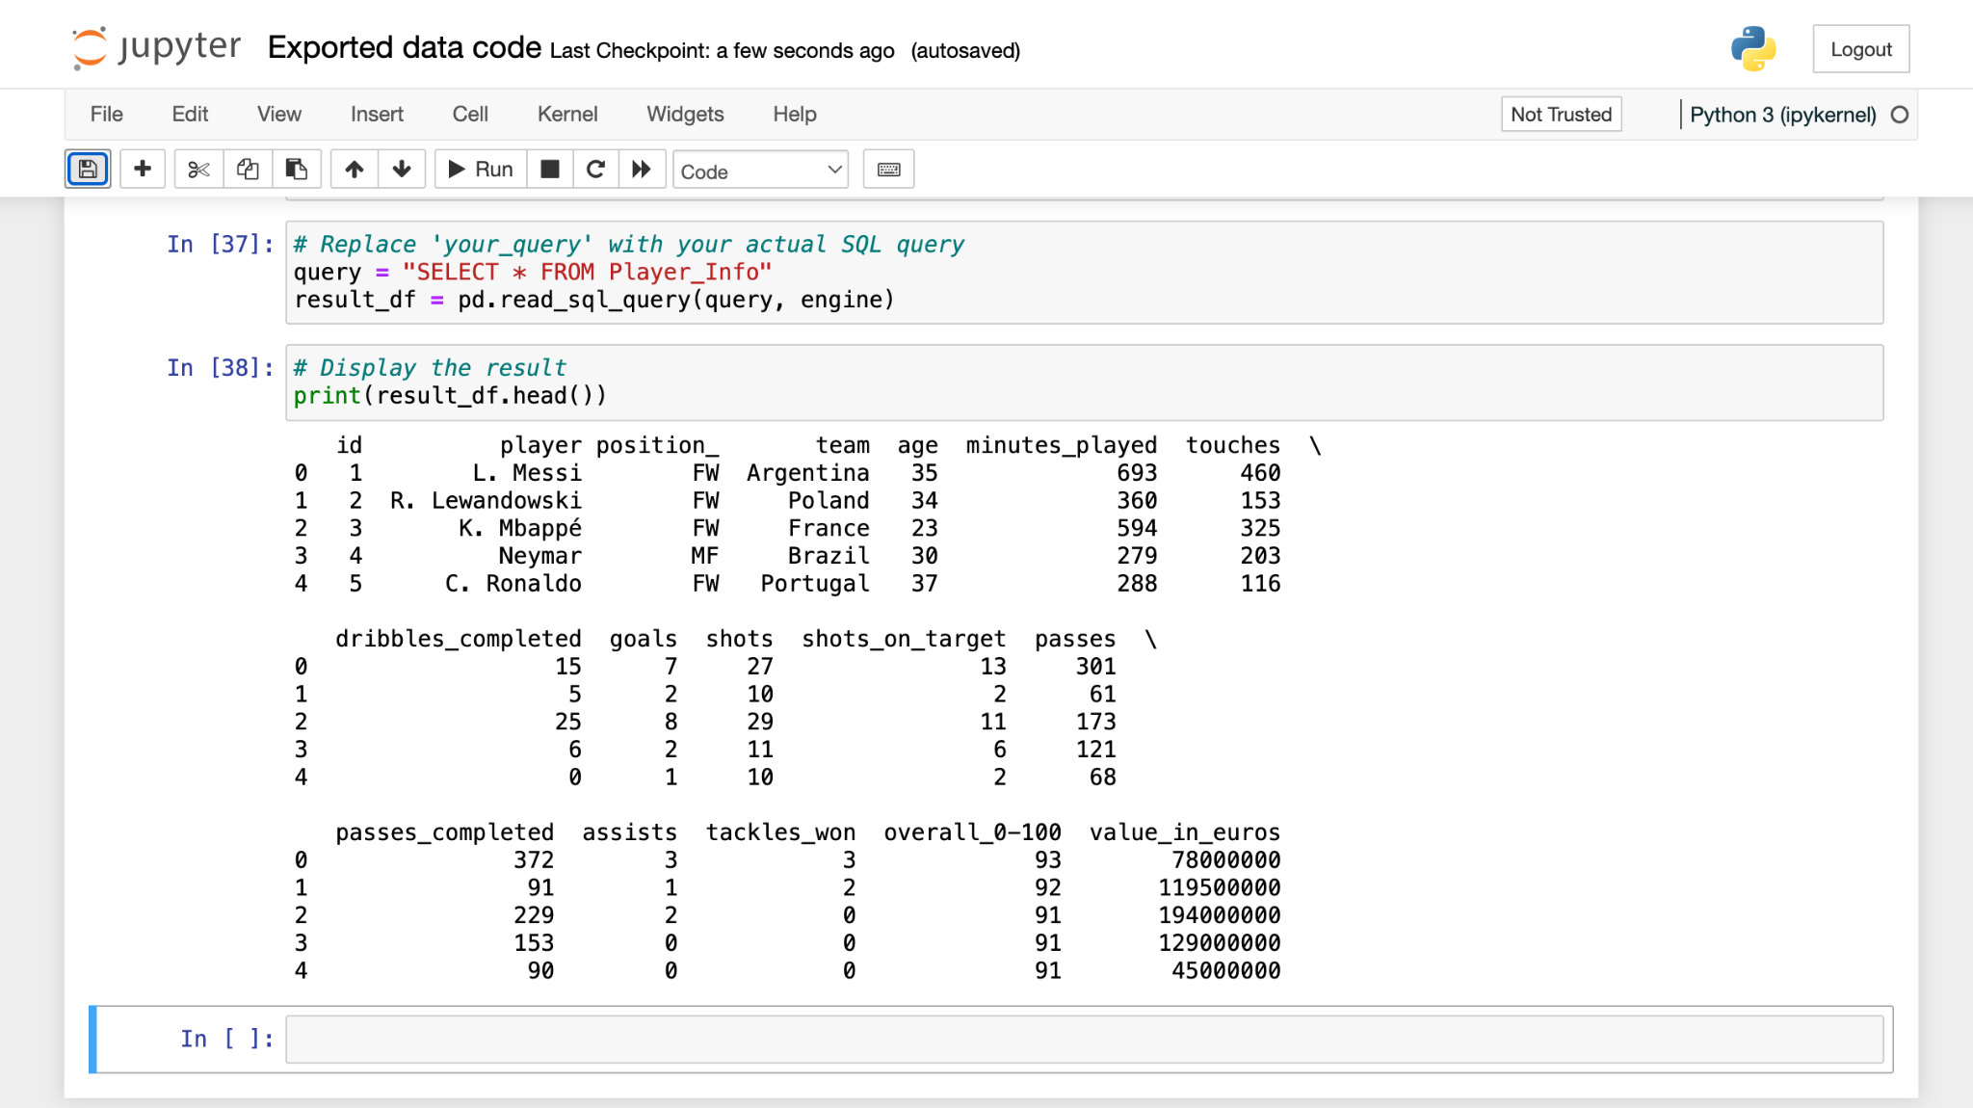
Exported Data

Slide 20
Ethical Considerations
Data privacy: We ensured that all of the data we extracted from Kaggle was compliant with data privacy regulations.
Consent: Since the data was extracted from Kaggle, a community platform that contains data free for public use, we obtained consent by agreeing to the site's terms and conditions.
Data usage: We maintained transparency in the ETL process by documenting all of the steps we took and made this information accessible to relevant stakeholders. We communicated the purpose of the data extraction and how we intend to use the data.

Slide 21
Thank you

